Slide 1

INSTITUTE - UIE
DEPARTMENT- ACADEMIC UNIT-2
Bachelor of Engineering (Computer Science & Engineering)
Subject Name: Basic Data Structure Using C++
Code:23CSH-103
Topic : Constructors & Destructors
DISCOVER . LEARN . EMPOWER

Slide 2


Basic Data Structure Using C++
Course Objectives
To enable the students to understand various stages and constructs of C++ programming language.
To improve their ability to analyze and address variety of problems in C++.

Slide 3



Course Outcomes
CO Number | Course Outcome
CO1 | Understand the concepts of object-oriented programming including programming process and compilation process.
CO2 | Apply different techniques to decompose a problem and programmed a solution with various concepts of object-oriented programming language.
CO3 | Analyse and explain the behaviour of linear data structure operations using the programming addressed in the course.
CO4 | Implement and evaluate the programs using the syntax and semantics of object-oriented programming.
CO5 | Design the solution of real-world problems in order to determine that the program performs as expected.

Slide 4

Scheme of Evaluation

Slide 5
What
It is a member function having same name as it’s class and
which is used to initialize the objects of that class type with a
legal initial value. Constructor is automatically called when
object is created.
Why
The purpose of constructor is to initialize the object of a class while the purpose of a method is to perform a task by executing java code. Constructors cannot be abstract, final, static and synchronised while methods can be. Constructors do not have return types while methods do.

Slide 6
CONTENTS
Need for Constructors
Types of Constructors
Notes:
Computer in the diagram is 3rd generation computer. The period of third generation was from 1965-1971. The computers of third generation used Integrated Circuits (ICs) in place of transistors. A single IC has many transistors, resistors, and capacitors along with the associated circuitry. The main features of third generation are −
IC used
More reliable in comparison to previous two generations
Smaller size
Generated less heat
Faster
Lesser maintenance
Costly
AC required
Consumed lesser electricity
Supported high-level language

Slide 7
Constructor
A constructor is a member function of a class which initializes objects of a class. In C++, Constructor is automatically called when object(instance of class) create. It is special member function of the class.
Syntax of Constructor:-
class A
{
public:
int x;
// constructor
A()
{
// object initialization
}
};

Slide 8
How constructors are different from a normal member function?
Constructor has same name as the class itself
Constructors don’t have return type
A constructor is automatically called when an object is created.
If we do not specify a constructor, C++ compiler generates a default constructor for us (expects no parameters and has an empty body).

Slide 9
Types of Constructors
1) Default Constructors:
Default constructor is the constructor which doesn’t take any argument. It has no parameters.
#include <iostream>
using namespace std;
class construct
{
public:
int a, b;
// Default Constructor
construct()
{
a = 10;
b = 20;
}
};
int main()
{
// Default constructor called automatically
// when the object is created
construct c;
cout << "a: " << c.a << endl
<< "b: " << c.b;
return 1;
}
Output:-
a: 10
b: 20
Note: Even if we do not define any constructor explicitly, the compiler will automatically provide a default constructor implicitly.

Slide 10
2) Parameterized Constructors:
It is possible to pass arguments to constructors. Typically, these arguments help initialize an object when it is created. To create a parameterized constructor, simply add parameters to it the way you would to any other function. When you define the constructor’s body, use the parameters to initialize the object.
// CPP program to illustrate
// parameterized constructors
#include <iostream>
using namespace std;
class Point
{
private:
int x, y;

Slide 11
int main()
{
// Constructor called
Point p1(10, 15);
// Access values assigned by constructor
cout << "p1.x = " << p1.getX() << ", p1.y = " << p1.getY();
return 0;
}
public:
// Parameterized Constructor
Point(int x1, int y1)
{
x = x1;
y = y1;
}
int getX()
{
return x;
}
int getY()
{
return y;
}
};
Output:
p1.x = 10, p1.y = 15

Slide 12
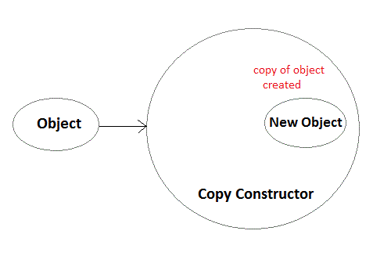
3) Copy Constructor:
Copy Constructor is a type of constructor which is used to create a copy of an already existing object of a class type. It is usually of the form X (X&), where X is the class name. The compiler provides a default Copy Constructor to all the classes.
Syntax of Copy Constructor
Classname(const classname & objectname)
{
. . . .
}
As it is used to create an object, hence it is called a constructor. And, it creates a new object, which is exact copy of the existing copy, hence it is called copy constructor.

Slide 13
#include<iostream>
using namespace std;
class copyconstructor
{
private:
int x, y; //data members
public:
copyconstructor(int x1, int y1)
{
x = x1;
y = y1;
}
/* Copy constructor */
copyconstructor (copyconstructor &sam)
{
x = sam.x;
y = sam.y;
}
void display()
{
cout<<x<<" "<<y<<endl;
}
};
/* main function */
int main()
{
copyconstructor obj1(10, 15); // Normal constructor
copyconstructor obj2 = obj1; // Copy constructor
cout<<"Normal constructor : ";
obj1.display();
cout<<"Copy constructor : ";
obj2.display();
return 0;
}
Output:-
Normal constructor : 10 15
Copy constructor : 10 15

Slide 14
Destructors
Destructor is a special class function which destroys the object as soon as the scope of object ends. The destructor is called automatically by the compiler when the object goes out of scope.
Syntax for destructor
The class name is used for the name of destructor, with a tilde ~ sign as prefix to it.
class A
{
public:
// defining destructor for class
~A()
{
// statement
}
};
Note:-
Destructors will never have any arguments.

Slide 15
Example to see how Constructor and Destructor are called
int main()
{
A obj1; // Constructor Called
int x = 1
if(x)
{
A obj2; // Constructor Called
} // Destructor Called for obj2
} // Destructor called for obj1
class A
{
// constructor
A()
{
cout << "Constructor called";
}
// destructor
~A()
{
cout << "Destructor called";
}
};
Output:-
Constructor called
Constructor called
Destructor called
Destructor called
When an object is created the constructor of that class is called. The object reference is destroyed when its scope ends, which is generally after the closing curly bracket } for the code block in which it is created.
The object obj2 is destroyed when the if block ends because it was created inside the if block. And the object obj1 is destroyed when the main() function ends.

Slide 16
When does the destructor get called?
A destructor is automatically called when: 1) The program finished execution. 2) When a scope (the { } parenthesis) containing local variable ends. 3) When you call the delete operator.
Destructor rules
1) Name should begin with tilde sign(~) and must match class name. 2) There cannot be more than one destructor in a class. 3) Unlike constructors that can have parameters, destructors do not allow any parameter. 4) They do not have any return type, just like constructors. 5) When you do not specify any destructor in a class, compiler generates a default destructor and inserts it into your code.

Slide 17
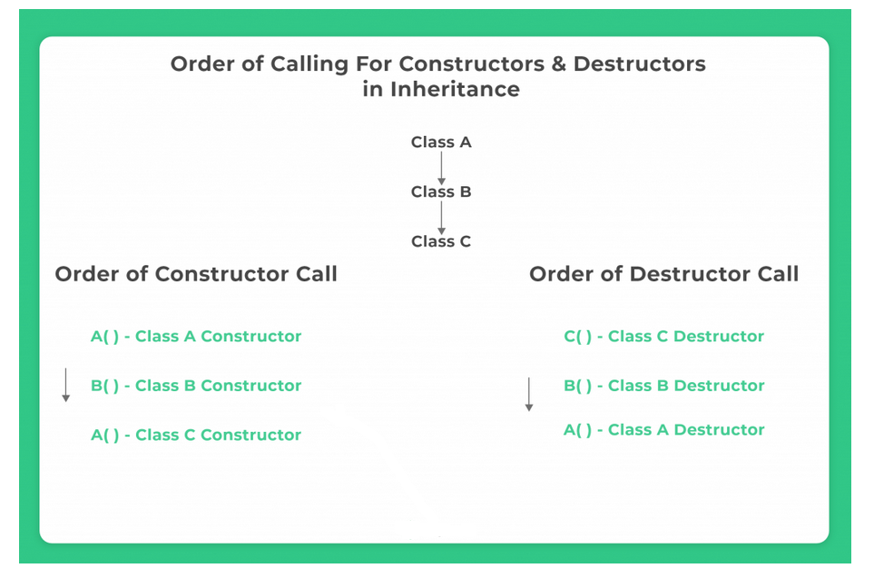
Order of Execution of constructor and destructor

Slide 18
Example 1
#include<iostream> using namespace std; class parent //parent class { public: parent() //constructor { cout<<"Parent class Constructor\n"; } ~parent()//destructor { cout<<"Parent class Destructor\n"; } };
int main() { parent c;
//automatically executes
//parent class
//constructors and destructors
// because of inheritance return 0; }
Output:-
Parent class Constructor Parent class Destructor

Slide 19
Example 2 using Inheritance
class child : public parent//child class { public: child() //constructor { cout<<"Child class Constructor\n"; } ~ child() //destructor { cout<<"Child class Destructor\n"; } };
#include<iostream> using namespace std; class parent//parent class { public: parent()//constructor { cout<<"Parent class Constructor\n"; } ~parent()//destructor { cout<<"Parent class Destructor\n"; } };
int main() { child c;
//automatically executes both
//child and parent class
//constructors and destructors
// because of inheritance return 0; }
Output:-
Parent class Constructor Child class Constructor Child class Destructor Parent class Destructor

Slide 20
Summary
In this lecture we have discussed about Constructor.
We have discussed about various types of constructor.
Moreover we have learnt about order of execution of constructor.
Discussed about destructor, and its needs.

Slide 21
Frequently Asked question
Q1 What is the use of a constructor?
Constructor is a special function having same name as class name. Constructor is called at the time of creating object to your class. Constructor is used to initialize the instance variables of an object while creating it. Constructor is also used to create virtual tables for virtual functions.
Q2 What is the order of constructor execution in C++?
First base class constructor is executed and then derived class constructor, so execution happens from top to bottom in inheritance tree.

Slide 22
Q3 What is the order of destructor execution in C++?
Generally derived class destructor, and then base class destructor. Except in case if we are taking a derived class object into a base class pointer (or reference variable), and we forget to give virtual keyword for base class destructor. See virtual destructor for details.
Q4 Is the default constructor created even if we create any other constructor?
Constructors are created by default by the compiler if a programmer doesn’t define any constructor explicitly. If the programmer defines a constructor then compiler holds its work and does not define any of it.

Slide 23
Assessment Questions:
1. Why constructors are efficient instead of a function init() defined by the user to initialize the data members of an object?
a) Because user may forget to call init() using that object leading segmentation fault b) Because user may call init() more than once which leads to overwriting values c) Because user may forget to define init() function d) All of the mentioned
2. What is a copy constructor?
a) A constructor that allows a user to move data from one object to another b) A constructor to initialize an object with the values of another object c) A constructor to check the whether to objects are equal or not d) A constructor to kill other copies of a given object.

Slide 24
3. What happens if a user forgets to define a constructor inside a class?
a) Error occurs b) Segmentation fault c) Objects are not created properly d) Compiler provides a default constructor to avoid faults/errors
4. How constructors are different from other member functions of the class?
a) Constructor has the same name as the class itself b) Constructors do not return anything c) Constructors are automatically called when an object is created d) All of the mentioned

Slide 25
5. State whether the following statements about the constructor are True or False.
i) constructors should be declared in the private section.
ii) constructors are invoked automatically when the objects are created.
A. True,True B. True,False C. False,True D. False,False
6. Destructors __________ for automatic objects if the program terminates with a call to function exit or function abort
A. Are called B. Are not called C. Are inherited D. Are created

Slide 26
Discussion forum.
Order of Execution of Constructors and Destructors in Inheritance in C++?
https://www.youtube.com/watch?v=fCK7sLu0G0Y

Slide 27

REFERENCES
Reference Books
[1] Programming in C++ by Reema Thareja.
[2] Programming in ANSI C++ by E. Balaguruswamy, Tata McGraw Hill.
[3] Programming with C++ (Schaum's Outline Series) by Byron Gottfried Jitender Chhabra, Tata McGraw Hill.
Websites:
https://en.wikipedia.org/wiki/Constructor_(object-oriented_programming)
https://www.programiz.com/cpp-programming/constructors
https://en.wikipedia.org/wiki/Destructor_(computer_programming)
YouTube Links:
What is Constructor? https://www.youtube.com/watch?v=q7aWkjH3UUI
What is destructor?
https://www.youtube.com/watch?v=D8cWquReFqw

Slide 28
THANK YOU

